Slide 1
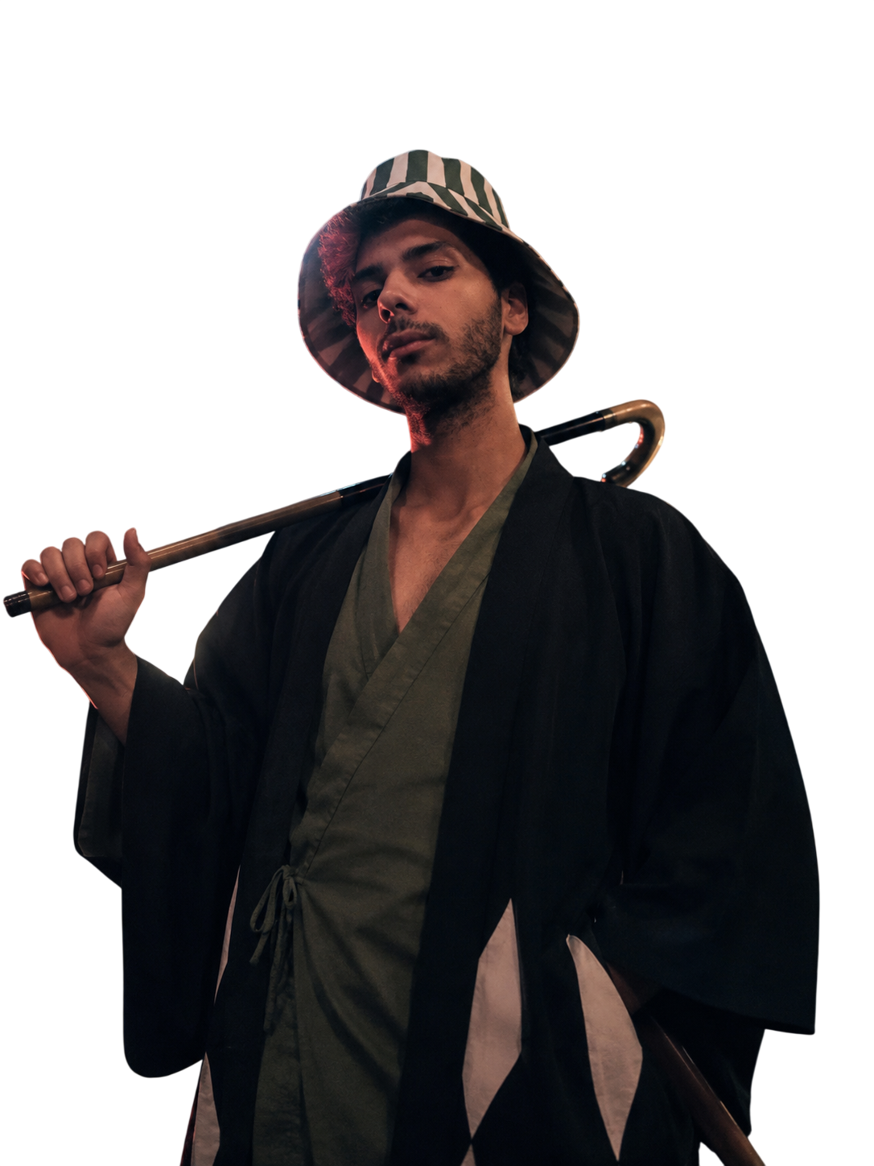

Creative
PORTFOLIO
PORTFOLIO
Omar Abdelaziz
engomarabd-elaziz.github.io/My-Portofolio
Graphic Designer
+20 102 046 8877

Slide 2

About me
I'm a creative mind with a passion for turning ideas into meaningful visual experiences.
I enjoy exploring the world of graphic design, experimenting with colors, typography, layouts, and visual compositions to create designs that are both aesthetically pleasing and purposeful.
For me, design is more than just making things look good
it's about communicating ideas, expressing creativity, and paying attention to the little details that make a difference.
Always curious, always learning, and always looking for new ways to bring ideas to life.

Slide 3

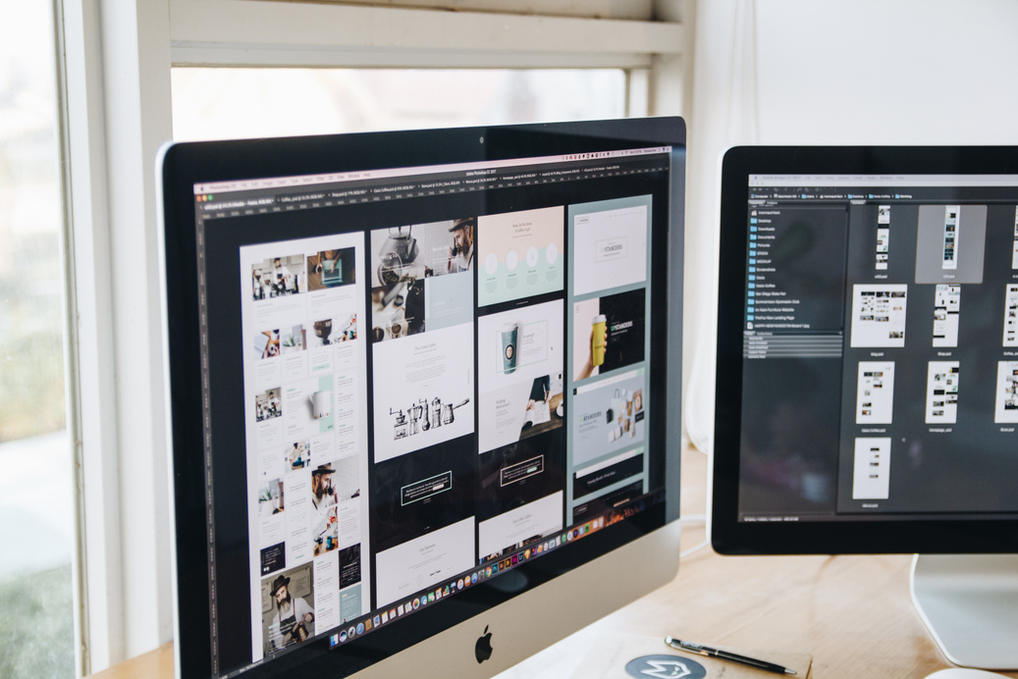
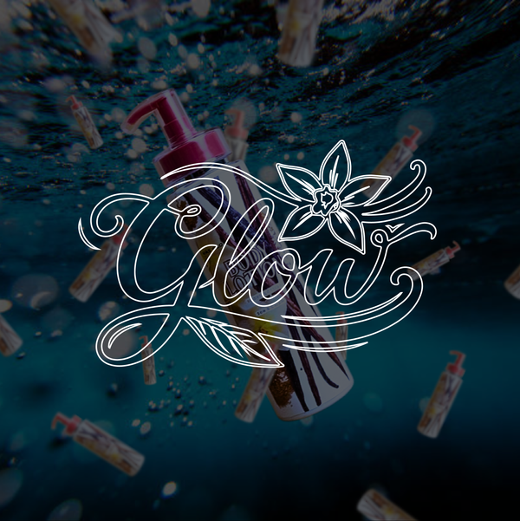
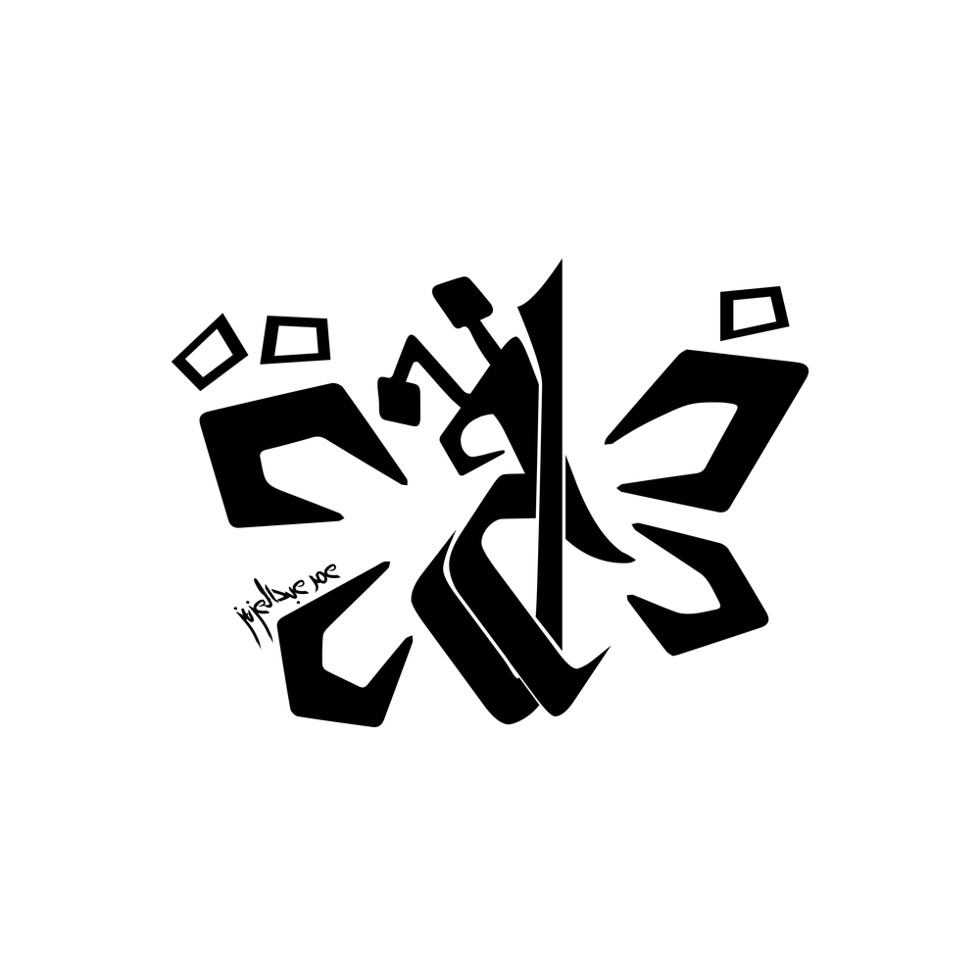
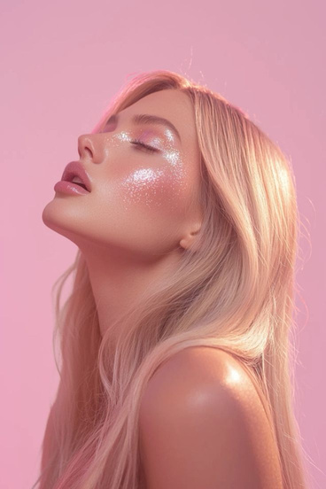
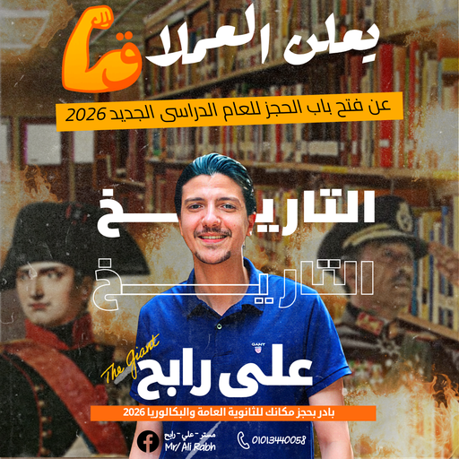
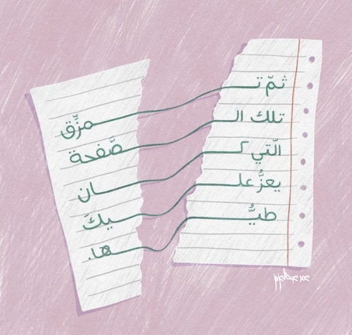
Skills
1
2
3
Graphic design
Photography
Branding
4
5
6
Social media design
Creative direction
Visual storytelling

Slide 4
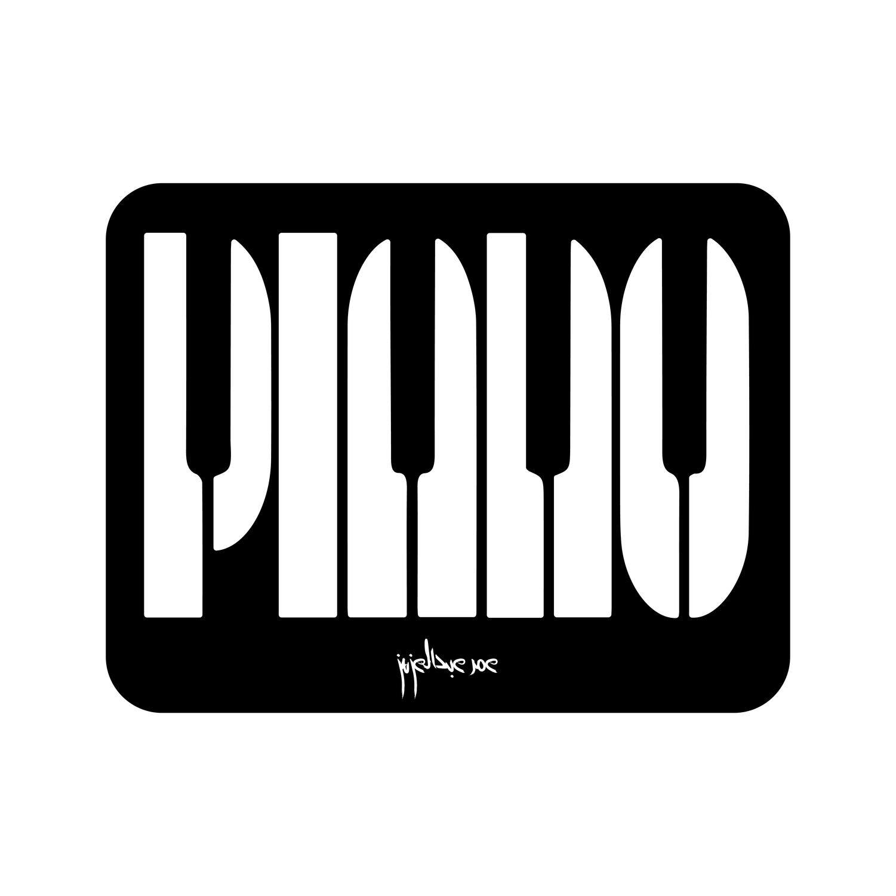
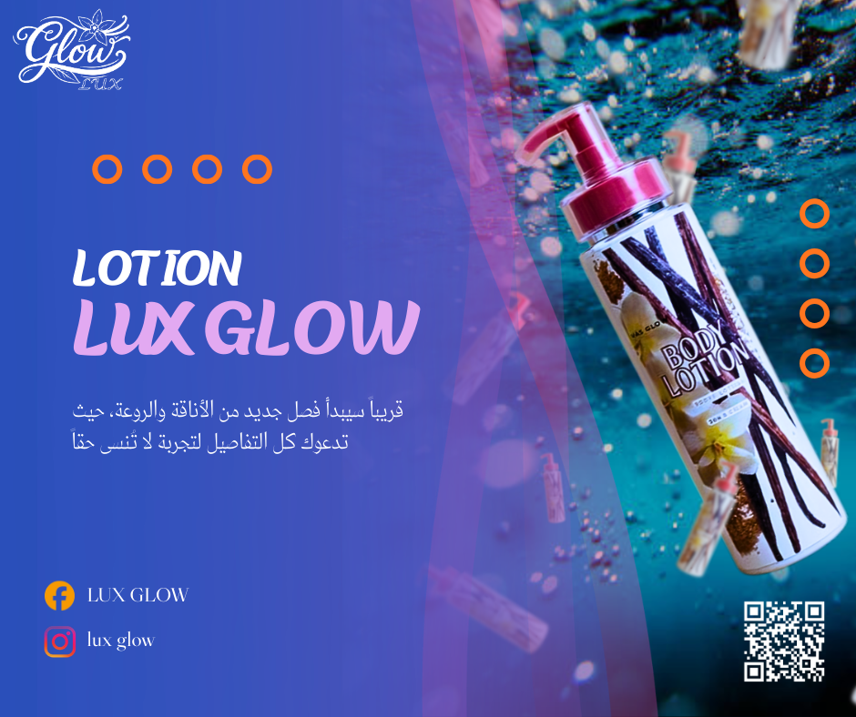
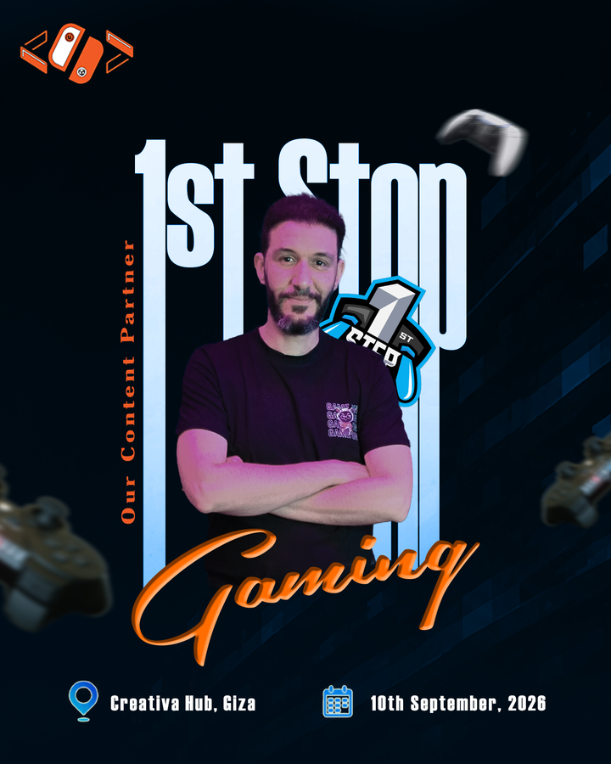
Creative style
Good design is not just seen, it's felt

Slide 5


Project 01
FCAI CU Game Development Club
A visual identity project for FCAI CU Game Development Club, a community dedicated to game development and creative technology.
The project focuses on creating a distinctive visual identity that reflects the club's passion for game development, creativity, and innovation.
From logo design to brand applications, the goal was to establish a consistent visual language that represents the community and gives it a recognizable presence across different platforms and activities.
Scope: Logo Design, Brand Identity, Visual Elements, Brand Applications.

Slide 6
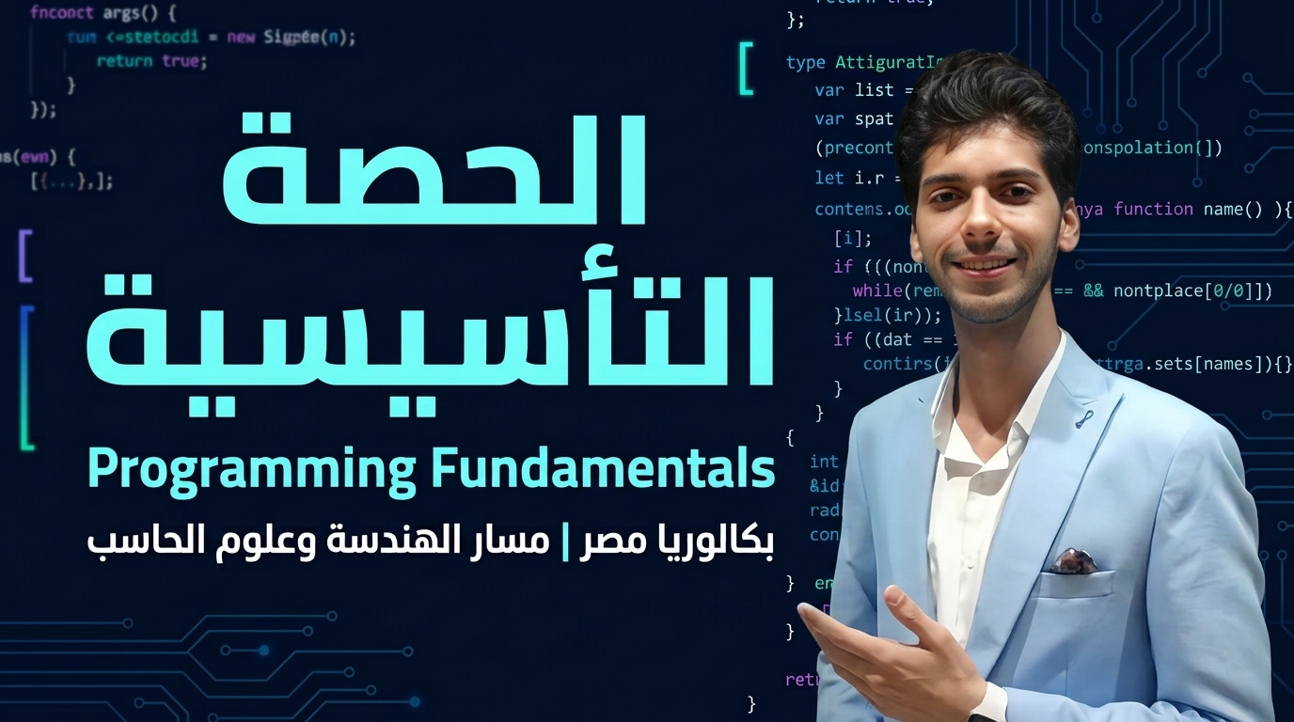
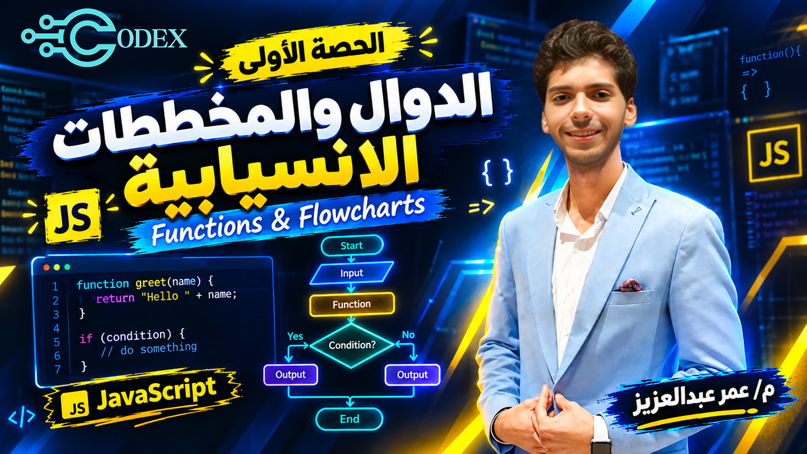
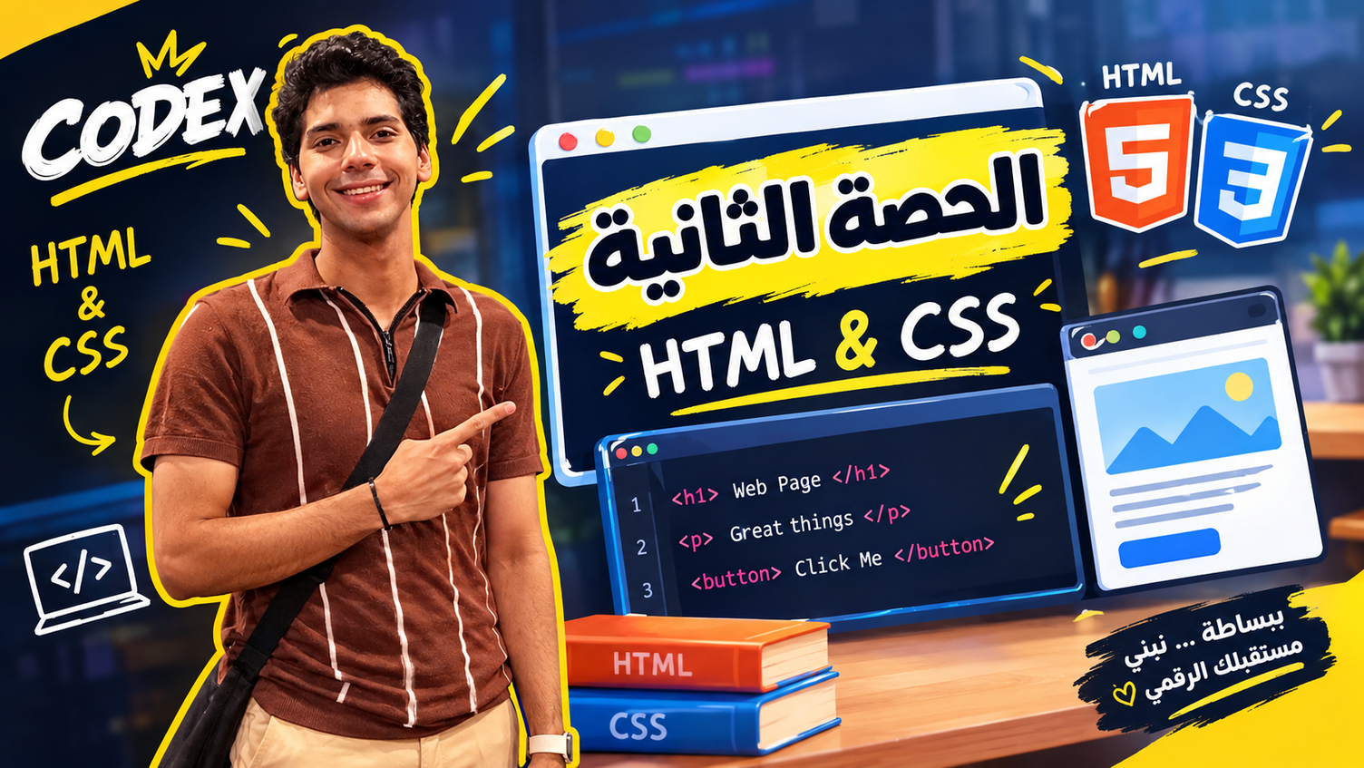
Project 02
Educational Content & Social Media Designs
A collection of visual designs created for my work as a Programming & AI instructor.
This project explores how visual communication can make educational content more engaging, clear, and appealing to students.
It includes social media designs, educational graphics, and YouTube thumbnails, all created to maintain a consistent visual style while making technical topics more approachable and visually interesting.
Scope: Social Media Design, YouTube Thumbnails, Educational Graphics, Visual Communication.

Slide 7
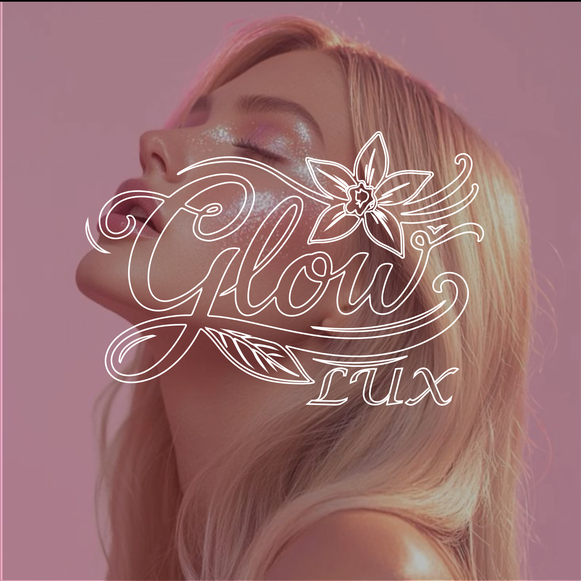
Project 03
LUX Glow — Brand Identity
A complete branding project for a beauty and personal care startup specializing in makeup, skincare, haircare, and body care products.
The project covers the visual identity from the initial logo concept to the overall brand experience, creating a cohesive look across different touchpoints.
From packaging labels and product visuals to social media content and advertising designs, every element is designed to communicate the brand's personality and create a consistent visual presence.
Scope: Logo Design, Brand Identity, Packaging Design, Product Labels, Social Media Design, Advertising.

Slide 8
Experiences
1
2024 — Graphic Design Trainee
at NASBEE in Egypt
2
2025 — Social media designer
at FCAI CU Game Development Club
3
2026 — Creative designer
Freelance at Khamsat & Mostaql

Slide 9
Let’s work together
Email:
omar.abdelaziz.gamedev@gmail.com
Social media:
www.behance.net/omar_13
Phone:
+20 102 046 8877

Slide 10

THANK YOU

